Slide 1


Who is God?
TheGOODGROUND.org
Notes:
Cover slide. Welcome the class and open in prayer.

Slide 2

GROUNDED CLASS
A 10-LESSON JOURNEY
LESSON THREE · GROUNDED CLASS
Who is God?
God is good. And more than good. He is love. It doesn’t matter who we think God is. It matters who God says He is.
Notes:
Lesson 3 of the Grounded class. Big idea: God is good. And more than good. He is love. We are not discovering God. He is showing Himself to us.

Slide 3

THE ONE TRUTH EVERYTHING ELSE HANGS ON
God Is Good. And More Than Good.
Psalm 34:8 (NIV)
1 John 4:8 (NIV)
“Taste and see that the LORD is good; blessed is the one who takes refuge in him.”
“Whoever does not love does not know God, because God is love.”
GOD IS LOVE
Not “God is loving,” like an emotion He expresses. It’s His nature. Everything else about Him flows from it. His power, His holiness, His judgment, all of it comes from a God who is love, and who loves you.
Notes:
Establish the one truth everything else hangs on: God is good. Not good on His good days. Good, period. And the Bible takes it further: God is love. Not "God is loving" like an emotion He expresses. It is His nature. His power is loving. His holiness is loving. His judgment is loving. All of it comes from a God who is love, and who loves you.

Slide 4

MOSES AT THE BURNING BUSH
Who Are You?
Exodus 3:13-14 (NIV)
“Moses said to God, “Suppose I go to the Israelites and say to them, ‘The God of your fathers has sent me to you,’ and they ask me, ‘What is his name?’ Then what shall I tell them?” God said to Moses, “I AM WHO I AM. This is what you are to say to the Israelites: ‘I AM has sent me to you.’””
I AM
I am not defined by anything else. I don’t depend on anyone. I didn’t come from anywhere. I have always been, and I always will be. Everything else that exists is because of Me.
Notes:
Moses stood before a burning bush and asked the most basic question a person can ask: Who are you? God’s answer sounds strange at first. But look at what He is saying. I am not defined by anything else. I don’t depend on anyone. I didn’t come from anywhere. I have always been, and I always will be. Everything else that exists is because of Me. I AM.

Slide 5
A
GOD HAS MADE HIMSELF KNOWN
Can a Person Even Know God?
God wants to be known. He didn’t hide. He revealed Himself. Four ways.
Notes:
Can a person even know God? Some say no. God is too big, too far, too mysterious. But that is not what the Bible says. God wants to be known. He went out of His way to make Himself known. Four ways.

Slide 6





A. FOUR WAYS GOD REVEALED HIMSELF
He Didn’t Hide
Through creation
Psalm 19:1-2 (NIV) “The heavens declare the glory of God; the skies proclaim the work of his hands. Day after day they pour forth speech; night after night they reveal knowledge.”
Through His Word
2 Timothy 3:16 (NIV) “All Scripture is God-breathed and is useful for teaching, rebuking, correcting and training in righteousness.”
Through His Son
John 1:18 (NIV) “No one has ever seen God, but the one and only Son, who is himself God and is in closest relationship with the Father, has made him known.”
Through His Spirit
Ephesians 1:17 (NIV) “I keep asking that the God of our Lord Jesus Christ, the glorious Father, may give you the Spirit of wisdom and revelation, so that you may know him better.”
Notes:
Creation shows His power. The Word tells us His heart. Jesus shows us His face. And the Holy Spirit makes it all real inside of us. God is not hiding from you. He has been revealing Himself to you your whole life. The question is whether you have been paying attention.

Slide 7

HE REVEALED HIMSELF THROUGH CREATION
Have you ever stood outside on a clear night and just looked up?
Saddle Road, Big Island of Hawaii. 6,632 feet above sea level. Everything pitch black. I stopped the Jeep, turned off the lights, got out, and looked up. You could see the Milky Way in all its wonder with your naked eye. Creation preaches a sermon every day: Somebody made this, and He is powerful.
Notes:
Personal story. Jennifer and I were on vacation on the Big Island of Hawaii, driving back to Waimea after a day in Hilo on Saddle Road, which rises to 6,632 feet. Everything was pitch black. I stopped the Jeep, turned off the lights, got out, and looked up. You could see the Milky Way with your naked eye. Mauna Kea is a Bortle class 1 or 2 sky: above the inversion layer, thin dry air, the cities hidden behind mountains, strict lighting ordinances. The band is bright enough to cast a faint shadow. It was amazing, and God created all of it.

Slide 8
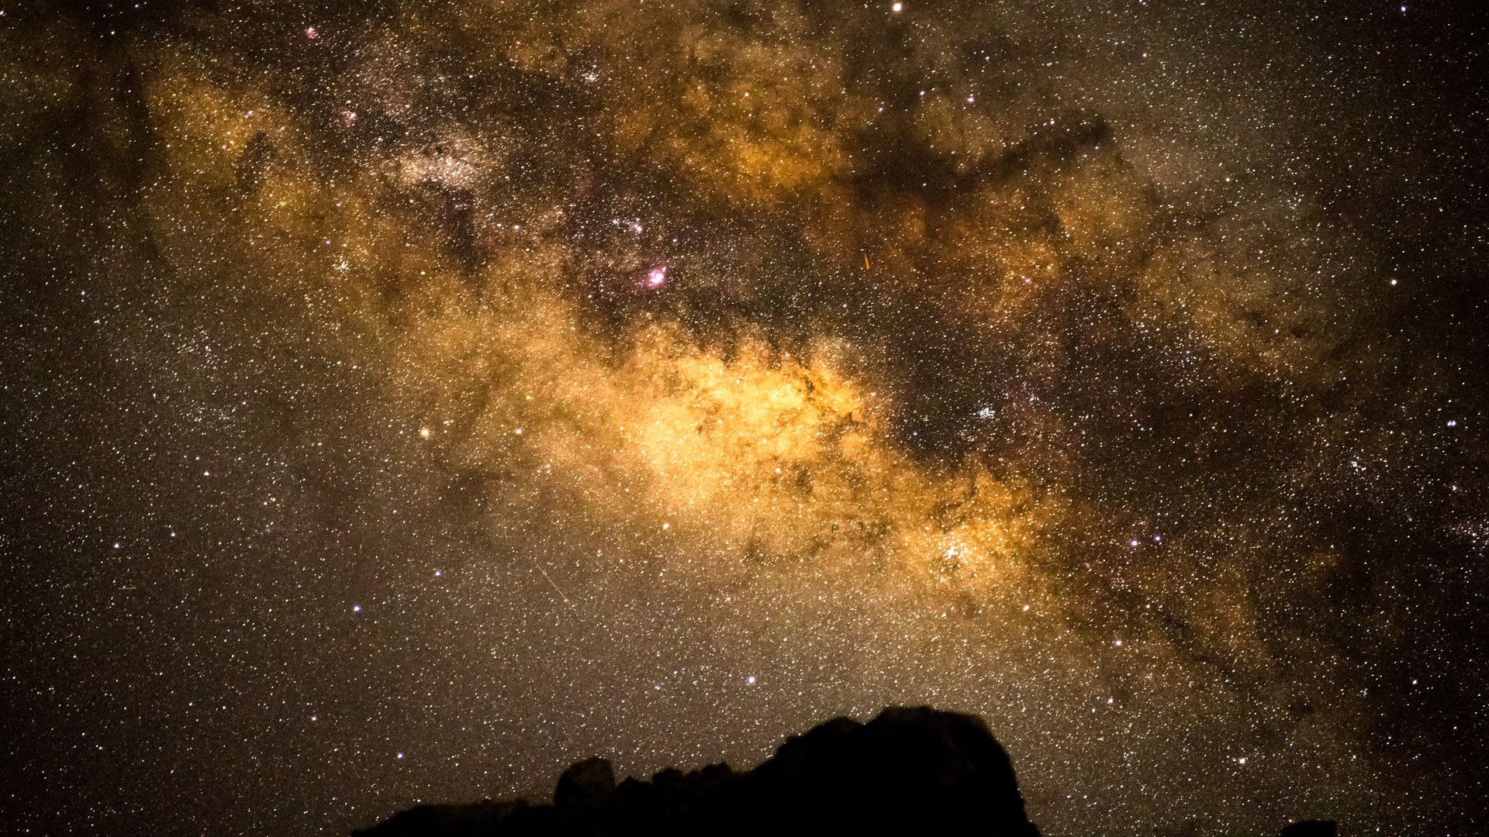
Psalm 19:1 (NIV)
“The heavens declare the glory of God; the skies proclaim the work of his hands.”
The Milky Way from Saddle Road, Big Island of Hawaii · 6,632 feet · Bortle class 1 sky · Dust lanes and the glowing galactic core, visible to the naked eye
Notes:
What the sky looks like from Saddle Road near Mauna Kea. Above the inversion layer, thin dry air, Hilo and Kona hidden behind mountains, strict lighting ordinances protecting the observatories. The band shows the dark Great Rift, dust lanes, and the bulge of the galactic core. You can learn a lot about an artist from his art. But creation can’t tell you His name or that He loves you. For that, He had to speak.

Slide 9
HE REVEALED HIMSELF THROUGH HIS SON
Look at Jesus
Hebrews 1:1-3 (NIV)
“In the past God spoke to our ancestors through the prophets at many times and in various ways, but in these last days he has spoken to us by his Son, whom he appointed heir of all things, and through whom also he made the universe. The Son is the radiance of God’s glory and the exact representation of his being, sustaining all things by his powerful word.”
THIS IS THE BIG ONE
If you want to know what God is like, look at Jesus. Not a rough sketch. Not close enough. The exact representation of His being. “Anyone who has seen me has seen the Father.” (John 14:9)
Notes:
This is the big one. If you want to know what God is like, look at Jesus. The exact representation of His being. Not a rough sketch. Not close enough. Exact. Want to know how God treats a sinner? Watch Jesus with the woman caught in adultery. How He feels about the sick and broken? Watch Jesus heal them. How He feels about you? Watch Jesus go to the cross. "Anyone who has seen me has seen the Father" (John 14:9).

Slide 10
B
GOD IS ONE, AND GOD IS THREE
The Trinity
One God, eternally existing as three Persons. Not a puzzle to solve. A mystery to behold.
Notes:
The Bible says there is one God. And the Bible also says the Father is God, Jesus is God, and the Holy Spirit is God. We call it the Trinity. You won’t find that word in the Bible, but you will find its truth on nearly every page. We covered this in the lesson on Jesus, and we cover it again on purpose, because this is a truth you have to hear more than once before it settles in.

Slide 11

B. ONE GOD, THREE PERSONS
One Name. Three Persons.
Deuteronomy 6:4 (NIV)
Matthew 28:19 (NIV)
“Hear, O Israel: The LORD our God, the LORD is one.”
“Therefore go and make disciples of all nations, baptizing them in the name of the Father and of the Son and of the Holy Spirit.”
LOOK CLOSELY
Baptize them in the name. Singular. One name. Then Jesus gives three: the Father, the Son, and the Holy Spirit. Three distinct Persons. Not one Person playing three parts. Not three gods. One God.
Notes:
First half: God is one. Second half: God is three Persons. Look closely at Matthew 28:19. Baptize them in the name. Singular. One name. But then Jesus gives three: the Father, the Son, and the Holy Spirit. And we see all three at the same time at Jesus’ baptism. The Son in the water, the Spirit coming down, the Father speaking from heaven. Three distinct Persons. Not one Person playing three parts. Not three gods.

Slide 12
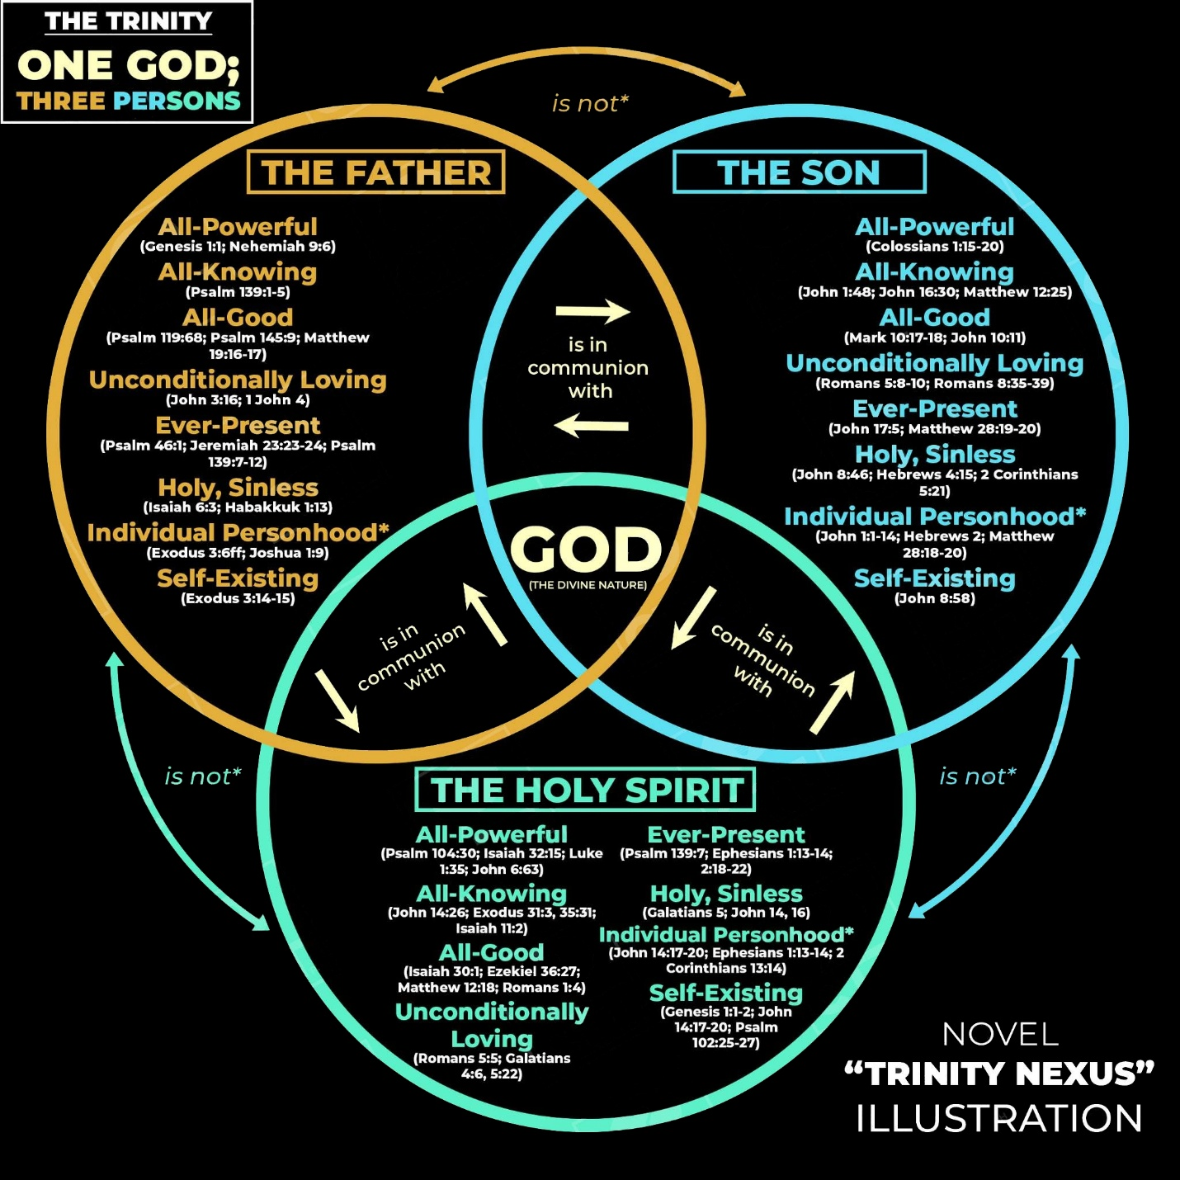
B. THE TRINITY
One God. Three Persons.
The Father is God. The Son is God. The Holy Spirit is God.
The Father is not the Son. The Son is not the Spirit. The Spirit is not the Father.
And there is only one God.
GENESIS 1:26 (NIV)
“Then God said, “Let us make mankind in our image, in our likeness, so that they may rule over the fish in the sea and the birds in the sky, over the livestock and all the wild animals, and over all the creatures that move along the ground.””
Notes:
Each circle is a Person. The arrows say "is not," because the Father is not the Son and the Son is not the Holy Spirit. But all three meet in the middle, in God. Same nature. Same attributes. Skip the water/ice/steam and egg illustrations; every one of them falls apart. Lean on what the Bible says. Every part of your Christian life involves all three: the Father planned your salvation, the Son purchased it, the Spirit applies it.

Slide 13
C
WHAT GOD SAYS ABOUT HIMSELF
In His Own Words
Not what people say about God. What God says about God. If God says it about Himself, it’s settled.
Notes:
When we studied Jesus, we looked at what Jesus claimed about Himself. Now the same with God the Father. Not what people say about God. What God says about God. If God says it about Himself, it’s settled.

Slide 14

C. "I AM COMPASSIONATE AND GRACIOUS"
God Describes Himself
Exodus 34:6-7 (NIV)
“And he passed in front of Moses, proclaiming, “The LORD, the LORD, the compassionate and gracious God, slow to anger, abounding in love and faithfulness, maintaining love to thousands, and forgiving wickedness, rebellion and sin. Yet he does not leave the guilty unpunished; he punishes the children and their children for the sin of the parents to the third and fourth generation.””
WHEN GOD DESCRIBES HIMSELF, HE STARTS HERE
Not with His power. Not with His judgment. With His compassion. And He is compassionate and just at the same time. That’s not a contradiction. That’s the cross.
Notes:
The most complete description God ever gave of Himself. Moses asked to see God’s glory, and this is what God showed him. Not lightning. Not thunder. His character. Read the list slowly. When God describes Himself, He starts with compassion. And notice the last line: He does not leave the guilty unpunished. God is compassionate and just at the same time. That’s not a contradiction. That’s the cross.

Slide 15

C. GOD’S OWN TESTIMONY
Five Things God Says About Himself
1
I AM.
Exodus 3:14 (NIV)
“God said to Moses, “I AM WHO I AM. This is what you are to say to the Israelites: ‘I AM has sent me to you.’””
2
God is spirit.
John 4:24 (NIV)
“God is spirit, and his worshipers must worship in the Spirit and in truth.”
3
God is light.
1 John 1:5 (NIV)
“This is the message we have heard from him and declare to you: God is light; in him there is no darkness at all.”
4
God is love.
1 John 4:8 (NIV)
“Whoever does not love does not know God, because God is love.”
5
I am holy.
1 Peter 1:15-16 (NIV)
“But just as he who called you is holy, so be holy in all you do; for it is written: “Be holy, because I am holy.””
Notes:
I AM: present tense, always. Not the God of the past or of someday. The God of right now. God is spirit: He isn’t on a mountain or in a building. The Maker, not the material. God is light: nothing shady, nothing deceptive. God is love: take love away and you don’t have God anymore. God is holy: set apart, completely other. That’s His own testimony. Believe Him.

Slide 16
D
THE CHARACTER OF GOD
The Three Omnis
“Omni” means all. All-powerful. All-knowing. All-present. No other being in existence can say that. Only God.
Notes:
Bible teachers call these God’s attributes, the truths about His nature. Three big words first: omnipotent, omniscient, omnipresent. Omni means all. All-powerful, all-knowing, all-present. No other being can say that. Not angels. Not the devil. Only God. David puts all three in one psalm, Psalm 139.

Slide 17

D. ALL-POWERFUL, ALL-KNOWING, ALL-PRESENT
The Three Omnis
1
Omnipotent
2
Omniscient
3
Omnipresent
He is all-powerful.
He is all-knowing.
He is all-present.
Jeremiah 32:17 (NIV)
Psalm 139:1-4 (NIV)
Psalm 139:7-10 (NIV)
“Ah, Sovereign LORD, you have made the heavens and the earth by your great power and outstretched arm. Nothing is too hard for you.”
“You have searched me, LORD, and you know me. You know when I sit and when I rise; you perceive my thoughts from afar. You discern my going out and my lying down; you are familiar with all my ways. Before a word is on my tongue you, LORD, know it completely.”
“Where can I go from your Spirit? Where can I flee from your presence? If I go up to the heavens, you are there; if I make my bed in the depths, you are there. If I rise on the wings of the dawn, if I settle on the far side of the sea, even there your hand will guide me, your right hand will hold me fast.”
WHY IT MATTERS What feels impossible to you is not impossible to Him.
WHY IT MATTERS He knows everything about you, and He loves you anyway.
WHY IT MATTERS You are never alone. Not once. Not ever.
Notes:
Omnipotent: no limit to what He can do. He spoke and galaxies showed up. He also knit you together one cell at a time. Nothing is too hard for Him. Omniscient: He knows everything and He loves you anyway. You can’t confess anything He doesn’t already know. Omnipresent: all of Him, everywhere, all the time. You are never alone. His schedule is never full. Let’s call upon Him!

Slide 18

D. SEVEN MORE
The Character of God
All-good
Unconditional love
Holy
Personal
Psalm 145:9 (NIV)
Romans 5:8 (NIV)
Isaiah 6:3 (NIV)
Joshua 1:9 (NIV)
“The LORD is good to all; he has compassion on all he has made.”
“But God demonstrates his own love for us in this: While we were still sinners, Christ died for us.”
“And they were calling to one another: “Holy, holy, holy is the LORD Almighty; the whole earth is full of his glory.””
“Have I not commanded you? Be strong and courageous. Do not be afraid; do not be discouraged, for the LORD your God will be with you wherever you go.”
All-sufficient
Unchanging
Faithful
Omnipotent. Omniscient. Omnipresent. All-good. Unconditionally loving. Holy. Personal. All-sufficient. Unchanging. Faithful.
That’s our God.
Psalm 90:2 (NIV)
Malachi 3:6 (NIV)
Lamentations 3:22-23 (NIV)
“Before the mountains were born or you brought forth the whole world, from everlasting to everlasting you are God.”
“I the LORD do not change. So you, the descendants of Jacob, are not destroyed.”
“Because of the LORD’s great love we are not consumed, for his compassions never fail. They are new every morning; great is your faithfulness.”
Notes:
Seven more. All-good: He will use everything He allows for good. Unconditionally loving: not after you cleaned up, while you were still a sinner. Holy: the attribute that keeps all the others in balance. Personal: not a force, not the universe, a Person who knows your name. All-sufficient: God doesn’t need you, He wants you. Unchanging: culture is the shifting shadow, He is the standard. Faithful: every promise He has made He has kept or will keep. That’s your God.

Slide 19
E
IF GOD IS GOOD, WHY IS THERE EVIL?
The Hardest Question
God did not create evil. He made the good. Sin is what we did with it.
Notes:
Now here it comes. If God is all-powerful and all-good, why did sin enter the world? Why did Adam and Eve fall? Why do bad things happen? This may be the biggest reason people struggle with God. But the struggle comes from not understanding God’s nature and character. Let’s break it down.

Slide 20

E. GOD MADE EVERYTHING GOOD
Where Did Evil Come From?
Genesis 1:31 (NIV)
Genesis 3:4-5 (NIV)
“God saw all that he had made, and it was very good. And there was evening, and there was morning—the sixth day.”
““You will not certainly die,” the serpent said to the woman. “For God knows that when you eat from it your eyes will be opened, and you will be like God, knowing good and evil.””
THE FIRST SIN WAS DOUBTING THAT GOD IS GOOD
The serpent didn’t lead with the fruit. He led with a lie about God’s character. Every sin since has started the same way. If you know who God is, the enemy’s lies don’t work.
Notes:
Start at the beginning. Everything God made was very good. No sin, sickness, death, or shame in the garden. So where did evil come from? Not from God’s hand. From a choice. God gave Adam and Eve everything and asked them to trust Him on one thing. Look at what the serpent did: he didn’t lead with the fruit. He led with a lie about God’s character. Is God holding out on you? The first sin was believing that God is not good. And every sin since has started the same way.

Slide 21
E. GOD WAS NOT SURPRISED, AND HE DID NOT STAY AWAY
The First Gospel
Genesis 3:15 (NIV)
“And I will put enmity between you and the woman, and between your offspring and hers; he will crush your head, and you will strike his heel.”
“I will put enmity”
“your offspring and hers”
“he will crush your head”
“you will strike his heel”
War between Satan and humanity. He is our enemy.
Hers, not his. A Son born of a virgin. Jesus.
A fatal wound. The serpent will be destroyed.
Painful, but not fatal. That’s the cross.
Notes:
The fall did not catch God off guard. On the very day sin entered the world, God made a promise. Speaking to the serpent, He makes four statements: enmity between Satan and the woman; between his offspring and hers (hers, not his: Jesus, born of a virgin); he will crush your head (a fatal wound to Satan); you will strike his heel (painful but not fatal: the cross). Theologians call it the first gospel, the Protoevangelium. The whole story of the Bible in one sentence.

Slide 22
F
GOD IS FATHER
Our Father in Heaven
Matthew 6:9 (NIV) “This, then, is how you should pray: “Our Father in heaven, hallowed be your name.””
Notes:
I saved the most important thing for last. Of everything God could have told us to call Him, here is the name Jesus chose. Father. Not Master, though He is. Not King, though He is. Not Judge, though He is. When Jesus taught us to pray, He said start with Father.

Slide 23

F. ABBA, FATHER
The Father Who Runs
Romans 8:15-16 (NIV)
Luke 15:20 (NIV)
“The Spirit you received does not make you slaves, so that you live in fear again; rather, the Spirit you received brought about your adoption to sonship. And by him we cry, “Abba, Father.” The Spirit himself testifies with our spirit that we are God’s children.”
“So he got up and went to his father. But while he was still a long way off, his father saw him and was filled with compassion for him; he ran to his son, threw his arms around him and kissed him.”
THAT IS WHAT GOD THE FATHER IS LIKE
Not waiting to punish you. Watching for you. Running toward you. You don’t come to God wondering if you’re allowed in the room. You come to Him because you belong there.
Notes:
Abba is the family word, what you called your father at home. Jews of that day did not address God as Abba in prayer. Jesus did, and it shocked them. Paul puts two pictures side by side: a slave and a son. The Holy Spirit didn’t make you a slave. He made you a son. The prodigal’s father was watching every day, looking down the road. In that culture a grown man did not run. He didn’t care. That is what God the Father is like.

Slide 24

F. WHEN "FATHER" IS A HARD WORD
Keep Your Eyes on Jesus
Psalm 118:8-9 (NIV)
“It is better to take refuge in the LORD than to trust in humans. It is better to take refuge in the LORD than to trust in princes.”
CHURCH HURT IS REAL HURT
A lot of it starts long before the hurt happens, when we put a person where only God belongs. When that person fails, because they are human, it feels like God failed. But God didn’t fail. A man did. Honor your leaders. Pray for them. Learn from them. But keep your eyes on Jesus, not on the person pointing you to Him. The one who hurt you was not Him.
Notes:
For some, the word father doesn’t feel good. God is not a bigger version of your earthly father. And church hurt is real hurt. A lot of it starts when we put a person where only God belongs. We make a pastor or leader the face of God in our lives, and when they fail, because they are human, it feels like God failed. But God didn’t fail. A man did. Honor your leaders. Pray for them. Learn from them. But keep your eyes on Jesus (Hebrews 12:2), not on the person pointing you to Him.

Slide 25
THIS WEEK'S CHALLENGE
Pray to God by a different name each day.
Each morning, take one name from the list. Read the verse where that name is found. Then pray to God using that name and thank Him for being that to you. “Jehovah Jireh, You are my Provider. Thank You that You see what I need today.” Keep it simple. Then watch for Him to show up as that name. Write down what you see.
Proverbs 18:10 (NIV) “The name of the LORD is a fortified tower; the righteous run to it and are safe.”
Yahweh. El Shaddai. Jehovah Jireh. Jehovah Rapha. Jehovah Shalom. Jehovah Raah. Abba, Father.
TheGOODGROUND.org · Grounded Class
Notes:
At the end of the lesson is a list of God’s names. Each morning take one name, read the verse where it is found, then pray to God using that name and thank Him for being that to you. Keep it simple. Then watch for Him to show up as that name. Write down what you see. Day 1 Yahweh, Day 2 El Shaddai, Day 3 Jehovah Jireh, Day 4 Jehovah Rapha, Day 5 Jehovah Shalom, Day 6 Jehovah Raah, Day 7 Abba.

